Slide 1
Project 0
My own project in 5 min

Slide 2
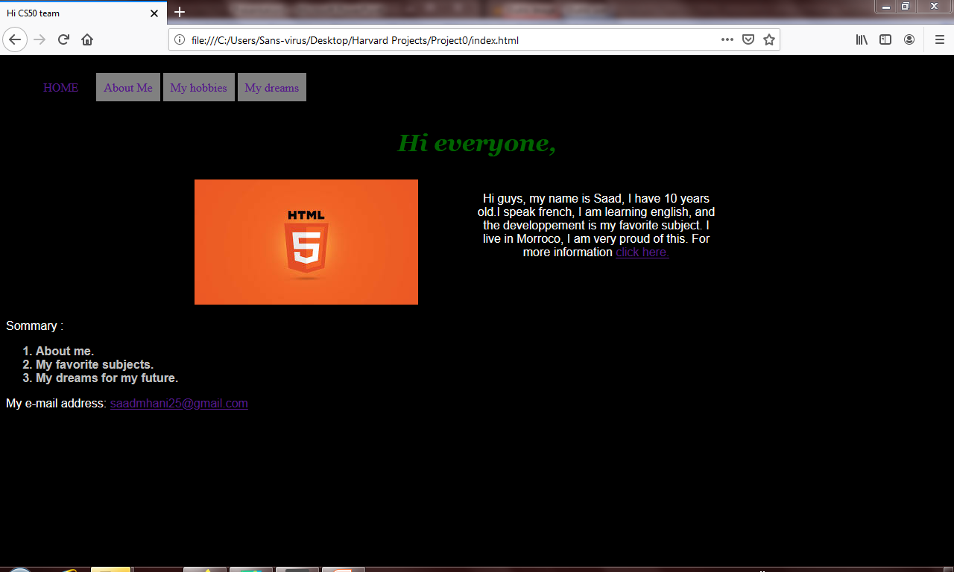
<- A unordered list
<- a big heading
<- a paragraph
<- A ordered list

Slide 3
The components of the previous page
We have a unordered list who gives a navigation bar.
We have a heading <h1> for the title page.
A pargraph who talk about me.
A ordered list for a plan.
And finally, my email in a paragraph: saadmhani25@gmail.com

Slide 4
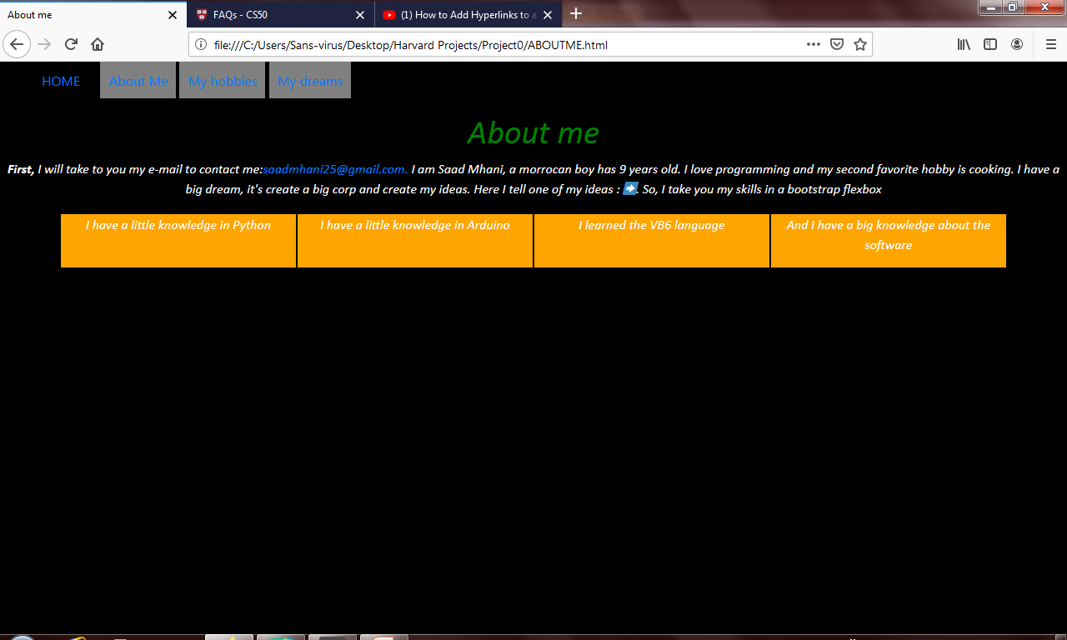
The second page

Slide 5
The second page components
There is a bootstrap flexbox, it tells about my skills.
A paragraph for a little presentation of me. There is spans in him for hyperlinks and the specification of the style of the words.
And finally, the title heading.

Slide 6
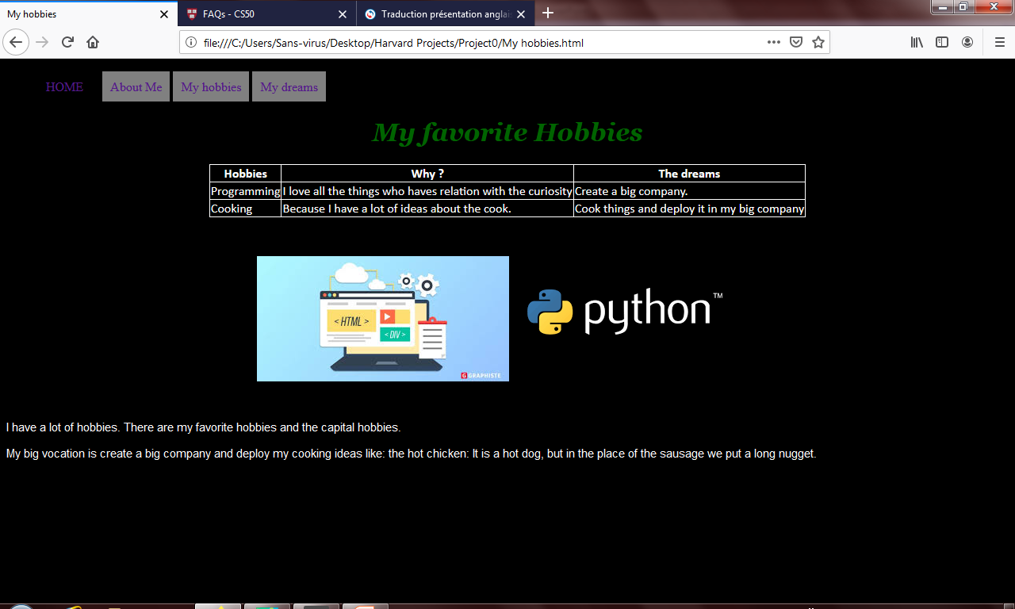
The thirst page

Slide 7
The thirst page components
Another title heading.
the hobbies table, it talks about my favorite hobbies and the most important for me.
Two programmation picture to explain my hobbies, and a tooltip for more informations about my skills.
And finally, a paragraph, it summarize the page.

Slide 8
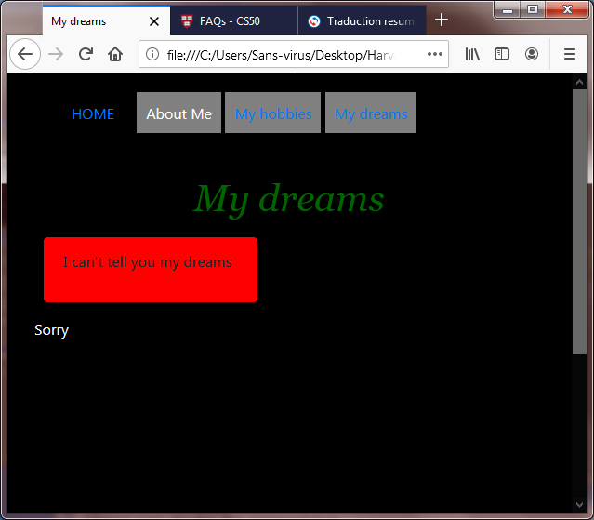
The fourth page and the final, part 1

Slide 9
The fourth page, part1 components
The heading is the title page.
We have a responsive media in the fourth page, if the page is little then it display a bootstrap alert message
And we have a pargraph in the bootom of the page, we can know about the chages of the responsive media.

Slide 10
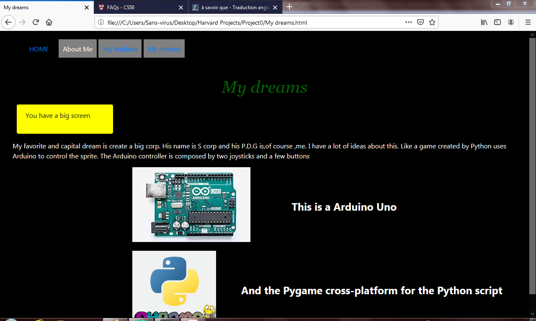
The fourth page, part 2

Slide 11
The finally page components
The pargraph change if we enlarge the window, we can see the paragraph.
There is two pictures it explain my project and big dream. There is an Arduino and a pygame photo.
And the alert message changes and displays a info message.

